Slide 1
2023 Pacific Northwest TERO Fall Conference
American Indian Chamber Education Fund APEX Accelerator
October 10, 2023
Venessa Gleich | Program Manager
Venessa.Gleich@aicccal.org

Slide 2
American Indian Chamber Education Fund
Funded in part through the Department of Defense (DoD) and the American Indian Chamber of Commerce of California.
No-Cost Government Contracting Assistance.
Supporting Native American businesses, Tribal enterprises, and Alaskan Native Corporations and State Advocates

Slide 3
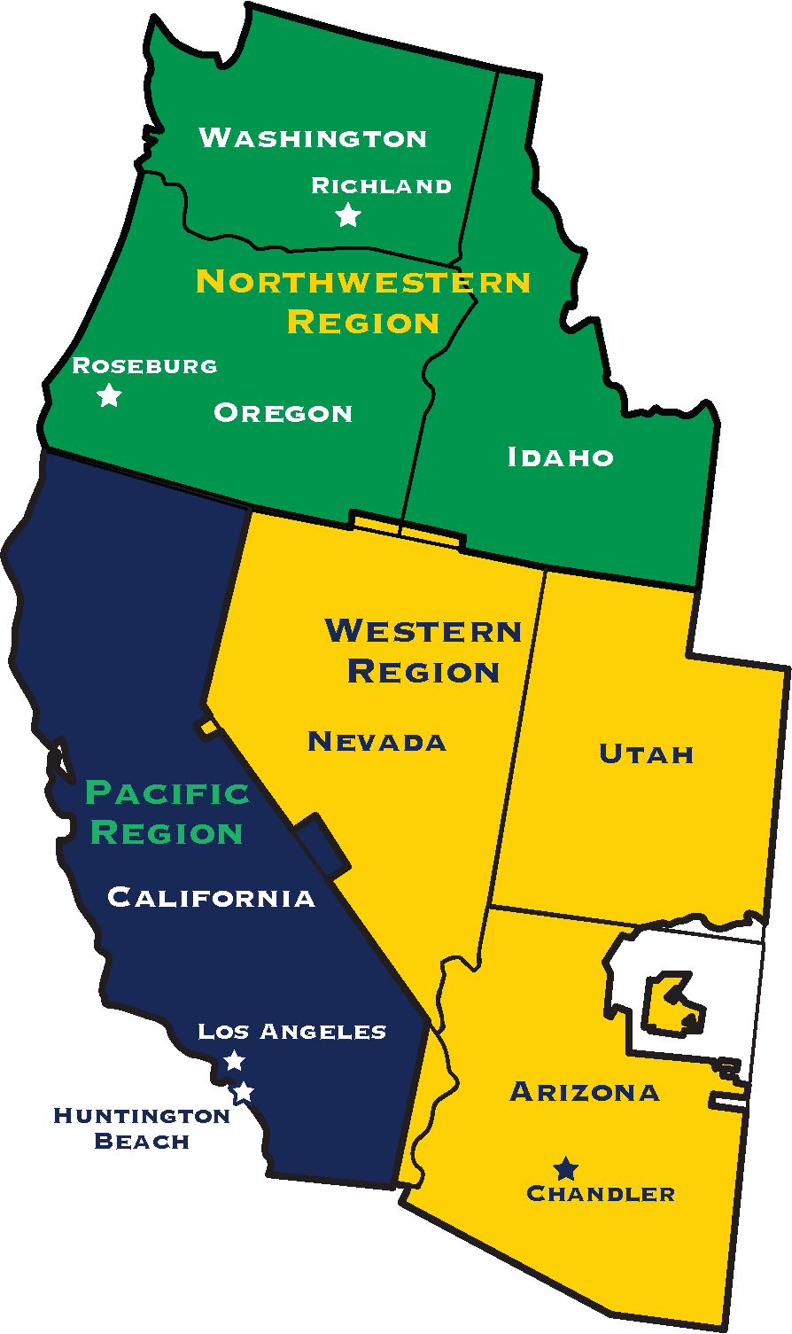
APEX Accelerators
96 APEX Accelerators nationwide
Help businesses compete & succeed in the federal marketplace
All services are no-cost: funded by Department of Defense, local grants, and private contracts.
In 2022, APEX Accelerators nationwide served over 98,000 clients and helped businesses win over 34 billion in government contracts and subcontracts.
100% Northwest Bureau of Indian Affairs Region:
Washington, Oregon, Idaho
100% Western Bureau of Indian Affairs Region:
Arizona, Nevada, Utah
100% Pacific Bureau of Indian Affairs Region:
California

Slide 4
AICEF APEX Accelerator Services for Clients
Certification application assistance.
Create capability statements
Market research – GovTribe, Proxity
Marketing to government, state, tribal agencies.
Unite businesses with purchasing & decision makers
Understand the market.

Slide 5
AICEF APEX Accelerator Services for Advocates
We can help advertise bid notifications
We can help find qualified vendors with specific certifications.
Provide specific training based on your needs.
Partner to host focused outreach events

Slide 6
What are your challenges with businesses? How can we help?

Slide 7
Think Outside the Box
How can we help to increase the number of Native American businesses that can work with your tribe?
What type of businesses do you want to work with? Low risk? High risk?
What mitigates the risk?
What are the guidelines?

Slide 8
Your Business and Economic Models
Which products/services are valuable to your you as the customer?
What is your pricing model?
What kinds of resources do you need?

Slide 9
Words of Advice to businesses
Answer any Questions which arise.
Inquire about any questions which may exist.
Use opportunity to show your expertise.
Demonstrate your positive qualities as a contractor
Be a business that the end user wants to hire.

Slide 10
CONTACT INFORMATION
Washington AICEF APEX Accelerator
719 Jadwin Avenue, Suite 23
Richland, WA 99352 (509) 581-7505
Jeremy Sandoval | Procurement Specialist
Jeremy.Sandoval@aicccal.org
Oregon AICEF APEX Accelerator
522 S.E. Washington
Roseburg, OR 97471
(541) 391-2992 Linda Sandoval | Procurement Specialist
Outreach@aicccal.org
Arizona AICEF APEX Accelerator
3200 N. Dobson Rd., Bldg. C, Suite 103
Chandler, AZ 85224 (480) 699-9529
Venessa Gleich | Program Manager
Venessa.Gleich@aicccal.org
California AICEF APEX Accelerator
5912 Bolsa Avenue, Suite 108
Huntington Beach, CA 92649 (213) 341-0104
ptacinfo@aicccal.org

