Slide 1
Puyallup Tribe of Indians
Tribal Occupational Safety & Health
Kimberly Turnipseed
Director & Trainer

Slide 2
Vision
It is our Vision to create an environment within the Puyallup Tribe of Indians Reservation that is free of hazards to ensure the prevention of injury and accidents for all those within our borders.
Notes:
Purpose: To assure that all workers are kept safe. Mission: Prevention through training and inspections.

Slide 3
Chain of Command
Tribal Council
Deputy Administrator
TOSH Director
TOSH Staff

Slide 4
Sovereignty
We have the right, as Tribal Nations, to enact our own OSH Laws.
We have the right to enforce our own laws
We have the right to cite violators within our jurisdiction
We have the right to require training

Slide 5
Federal Law
Are we bound by Federal OSHA Laws?
Yes & No-There is mixed precedent in Federal Courts in regards to Tribal Nations and OSHA Laws
Scalia v. Red Lake Nation Fisheries-8th Circuit-NO
US Dept. of Labor v. Oshre-9th Circuit-YES
Donovan v. Coeur d’Alene-9th Circuit-YES
Donovan v. Navajo Forest Products-10th Circuit-NO
Reich v. Mashantucket Sand & Gravel-2nd Circuit-YES
Menominee v. Solis-7th Circuit-YES
We choose to err on the side of caution and follow Federal OSHA Laws. Our code is written with the “Adoption by Reference” of Federal OSHA Standards. It expressly states we are not giving up our sovereignty.
We have the ability to strengthen the code where we feel necessary to better protect our workers.

Slide 6
Federal vs. state
Federal: Applies to Tribes**, States, and Native Contractors on Tribal Land within our jurisdiction (Trust or Fee)
State: Non-Native Contractors even on Trust* or Fee Lands are subject to State OSH Laws where applicable
Not all states have an approved State OSHA Plan
* Check with your Law Office
** Mixed Precedent in Federal Court of Applicability

Slide 7
Benefits
We keep control
Penalties can bring in income
Spend 50k today to potentially save more than 1 million or more in L&I Claims, Penalties, and Family Payouts

Slide 8
Estimated Total Cost table
Injury Type | Instances | Direct Cost | Indirect Cost | Total Cost | Additional Sale (Indirect) | Additional Sale (Total)
Burn | 1 | $47,192 | $51,911 | $99,103 | $5,191,120 | $9,910,300
Amputation | 1 | $96,003 | $105,603 | $201,606 | $10,560,330 | $20,160,600
Carpal Tunnel Syndrome | 1 | $30,930 | $34,023 | $64,953 | $3,402,300 | $6,495,300
Hernia | 1 | $20,940 | $23,034 | $43,974 | $2,303,400 | $4,397,400
Mental Stress | 1 | $35,151 | $38,666 | $73,817 | $3,866,610 | $7,381,700
From OSHA.GOV Cost Estimator

Slide 9
Training
OSHA 10 for Construction & General Industry
OSHA 30 for Construction & General Industry
Specialized Safety & Health Modules
CPR/First Aid/AED
AVERT (Active Violence Emergency Response Training)

Slide 10
Class Cost
OSHA 10 is $150.00 per person
OSHA 30 is $350.00 per person
CPR/First AID/AED is $50.00 per person
AVERT is $150.00 per person
Prices subject to change without notice
Minimum attendance for Class is 3 people
Group Discounts Available
All class prices are in addition to Travel Costs
Notes:
TERO is currently not charged, however; we will be charging them for clients and staff at a future time. They will not be charged for IP Contractors or non-native contractors. We will charge the companies directly for the training. In my research, our prices are on the lower end of the spectrum.

Slide 11
Making Mandatory
Tribal Governments can require OSHA Laws, OSHA Training, other relevant Trainings
TERO Commissions can require all clients attend
Have removed from site if not completed
Ineligible for TERO Referrals until completed
We are asking for a 6 month
Grace Period after the law is
passed.

Slide 12
Enforcement
TOSH enforces current Federal and State OSHA Laws (Federal-Tribal Contractors, State-non Tribal Contractors)
Site Checks
Investigation of Safety Violations
Investigation of Complaints from Workers
Investigate all serious Incidents that occur
Provide Up to Date, Relevant, and Continuous Training

Slide 13
Inspections
Imminent Danger
Investigative
Employee Complaint
Programmed
Follow-up

Slide 14
Code
Puyallup Tribe has completed the code, sent it out for Public Comment, and am currently working on the Resolution.
Code can be customized for Tribal needs
We are developing a separate Dive & Fishing Code
We cover everything from General Industry to Maritime
We may get into Agriculture in the future

Slide 15
Grants
Working to obtain Grants
Susan Harwood Grant
SHIP Grants
Federal Programs
State Programs

Slide 16
Fines/Citations
Per OSHA, citation amounts must be at least set to their minimums.
Will be set by Tribal Government
Can be negotiated to be lowered, situationally dependent
Notes:
In April 2022 OSHA started the process to revoke AZ right to have a state OSHA plan based solely on the fact that they were not enforcing citations at the minimum of the federal amount. I am making the recommendation to my Tribal Council and law office to have

Slide 17
CPR& AVERT
CPR/First Aid/AED
AVERT
Respond to minor incidents
Learn use of emergency equipment
Use at work or home
Gain Confidence
Save a Life
Violence in this country is on the rise
Most Mass Shootings happen in the workplace
Learn best response for survival
Learn major wound care, wound packing, & tourniquet use

Slide 18
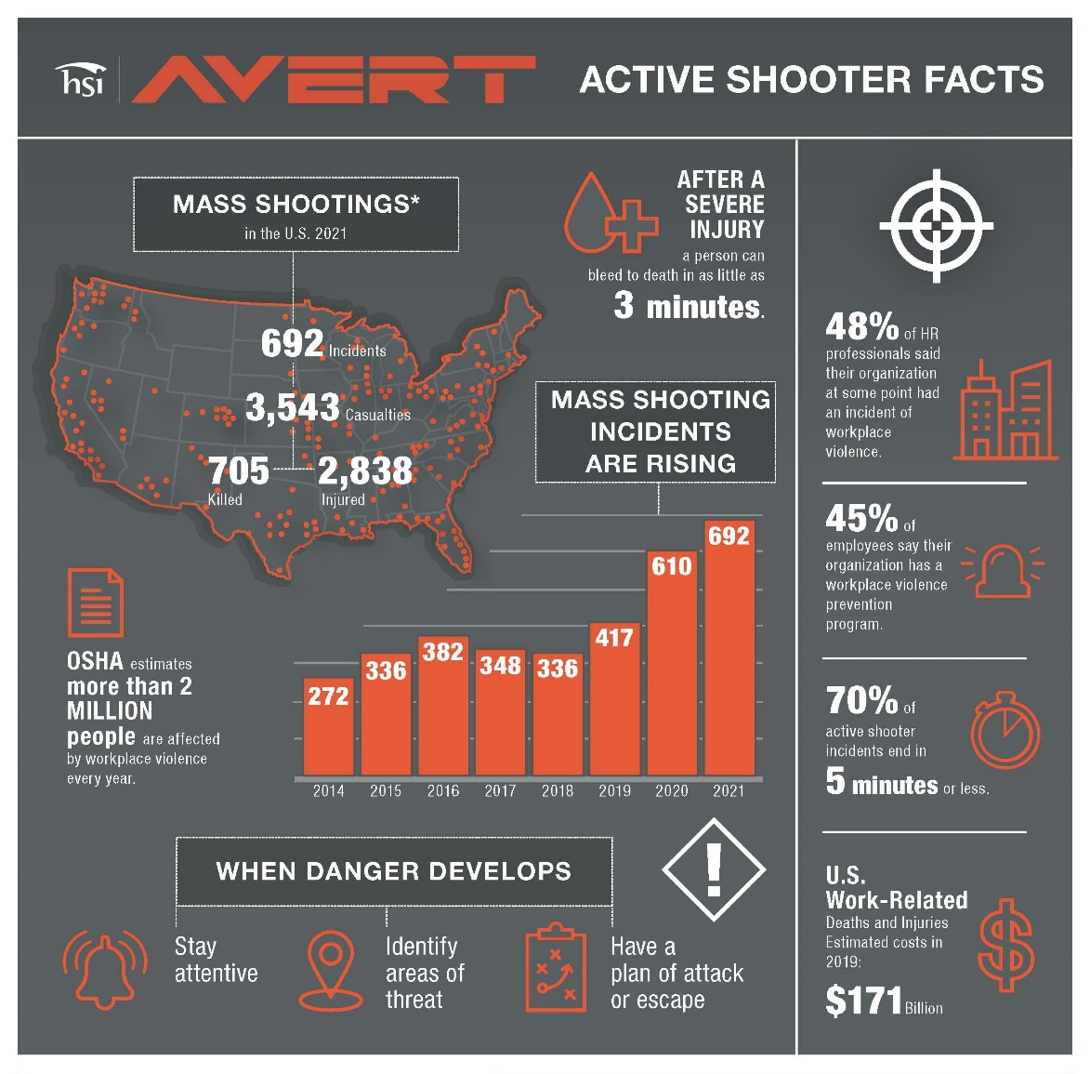

Slide 19
TERO
Working Together-PTOI TERO are all trained to recognize safety hazards and communicate continuously with TOSH-They maintain an OSHA 30 Card and attend update trainings.
Provide Mail-outs or Mailing List of TERO Clients
Promote the scheduled trainings
Registration of Clients for Classes
Provide List of all Job Sites and Contractors; including subs
Refer Contractors to TOSH for Safety Compliance

Slide 20
Questions?

Slide 21
Thank you!
Kimberly Turnipseed
Puyallup Tribe of Indians
3009 E. Portland Ave
Tacoma, WA 98404
(253) 778-3696
Kim.Turnipseed@puyalluptribe-nsn.gov

