Slide 1




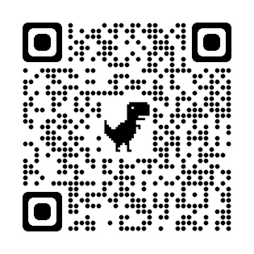


NW WA Electrical Industry JATC
Two Locations:
www.nwejatc.org
306 Anderson Rd, Mount Vernon, WA
478 2nd St SE, East Wenatchee, WA

Slide 2
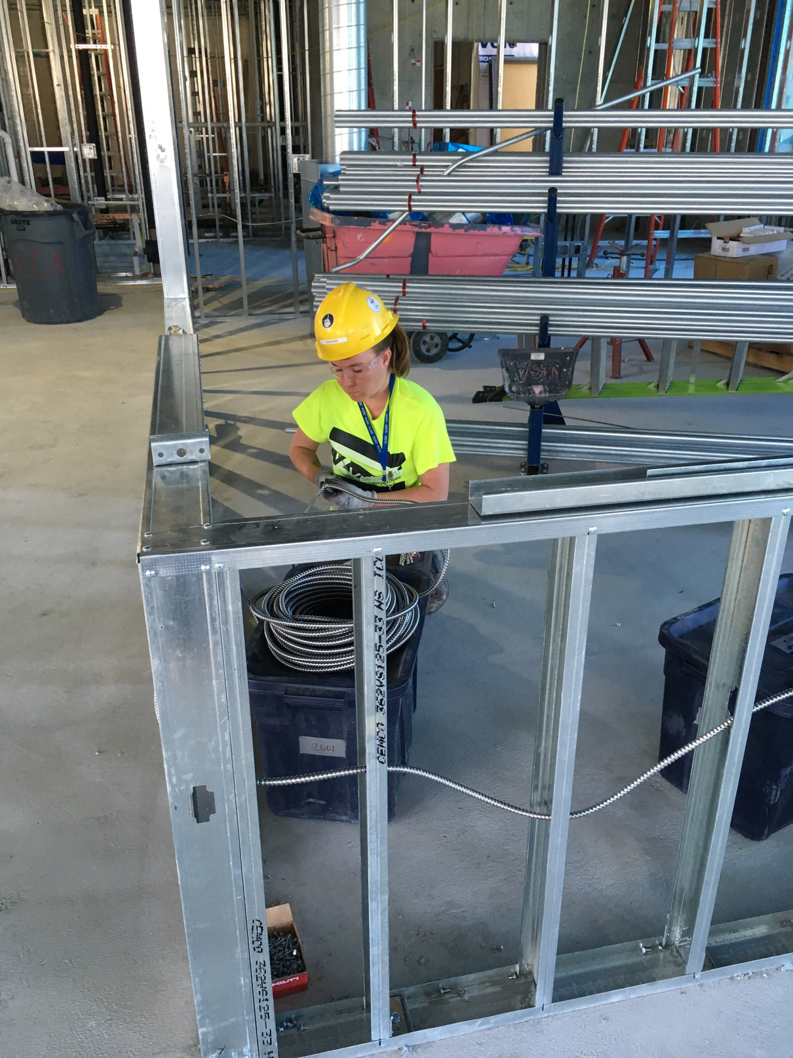
Earn While You Learn Program
On-the-job Training
Supplemental Classroom Instruction
Program of Learning

Slide 3

NWEJATC Electrical Apprenticeship
No Student Loans
The apprenticeship is tuition free
Opportunity
To start training for a lucrative career
Get Paid
You get paid from day one

Slide 4
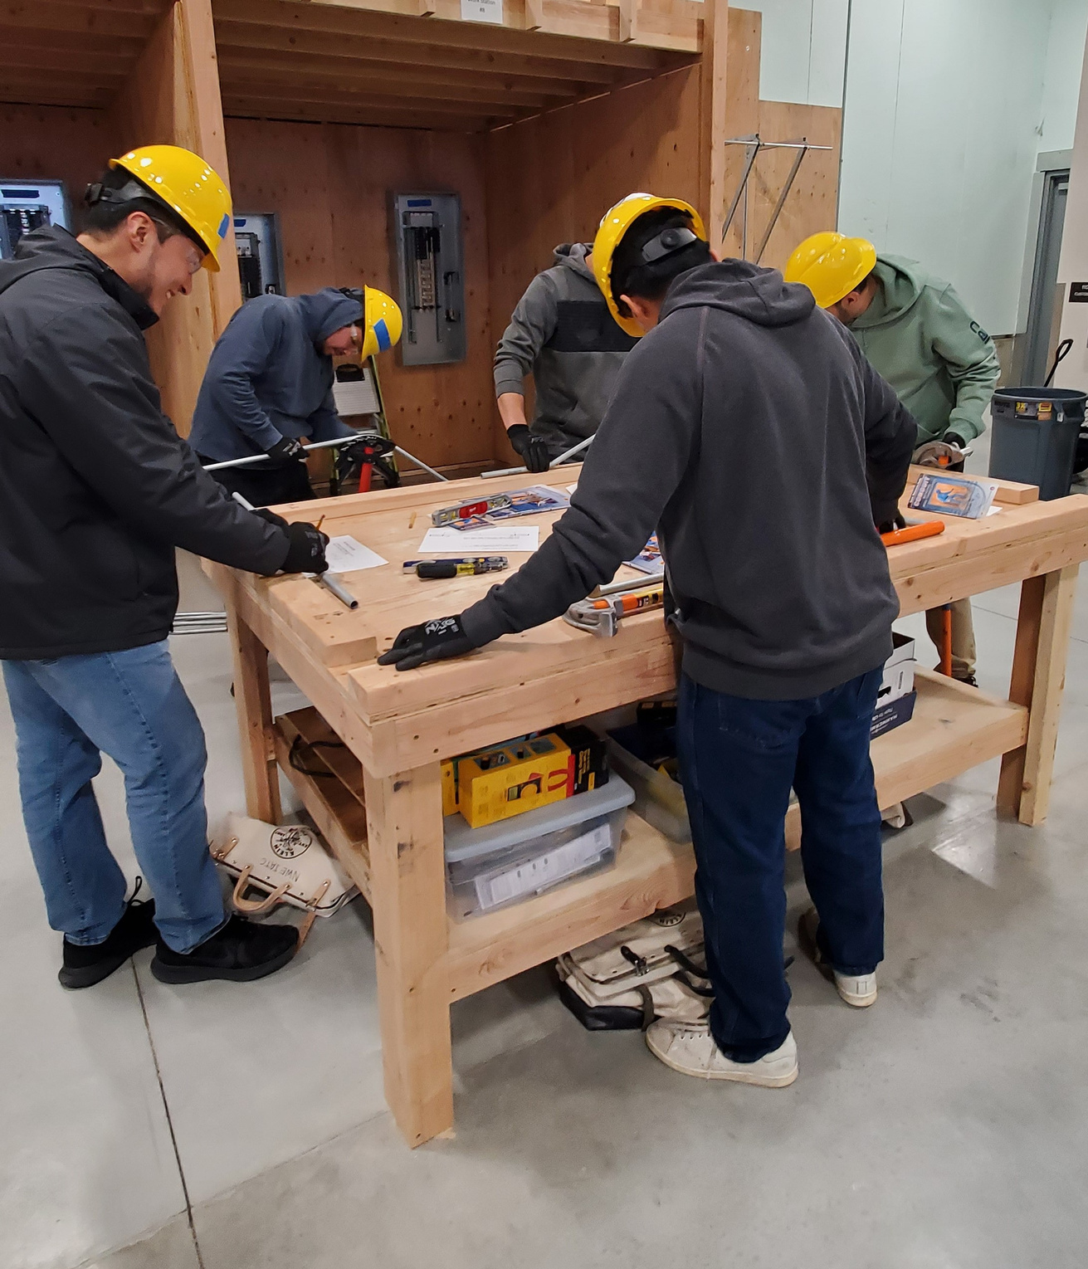
Why the JATC?
Gain a highly employable skill that is always in demand.
The apprenticeship is tuition free - NO Student Debt
Earn while you learn - Get paid from day one
Wage benefits increase frequently
Family quality health benefits
Immediate contributions to your pensions

Slide 5
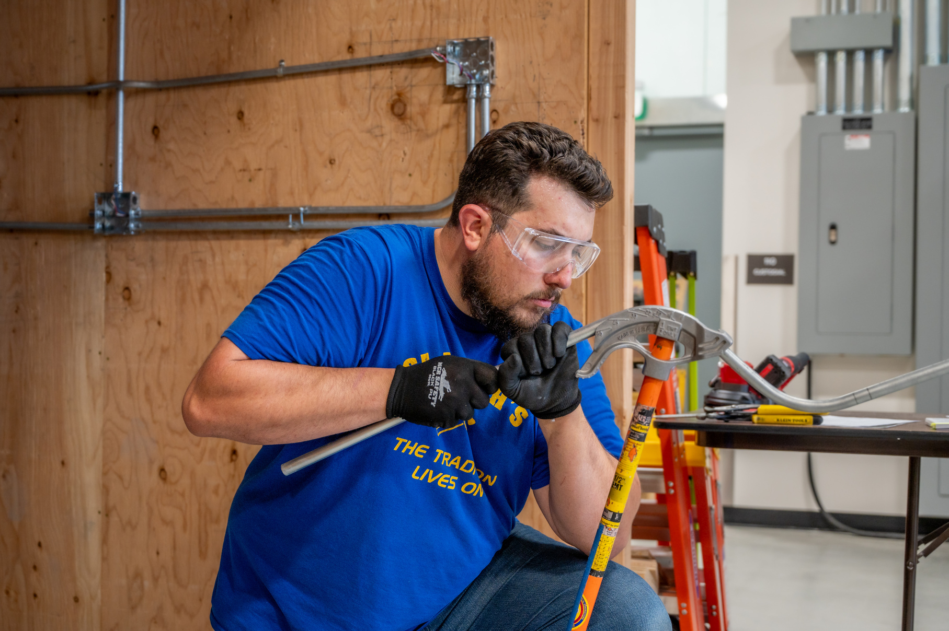
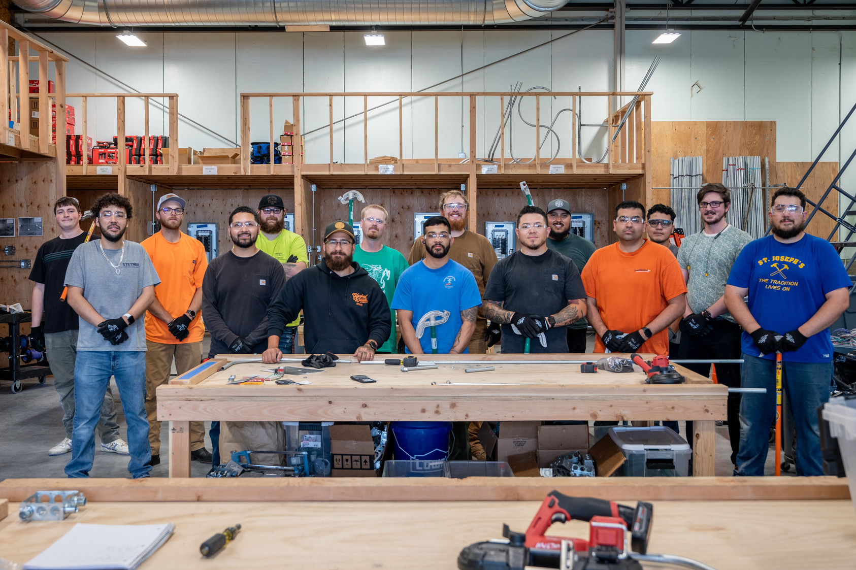
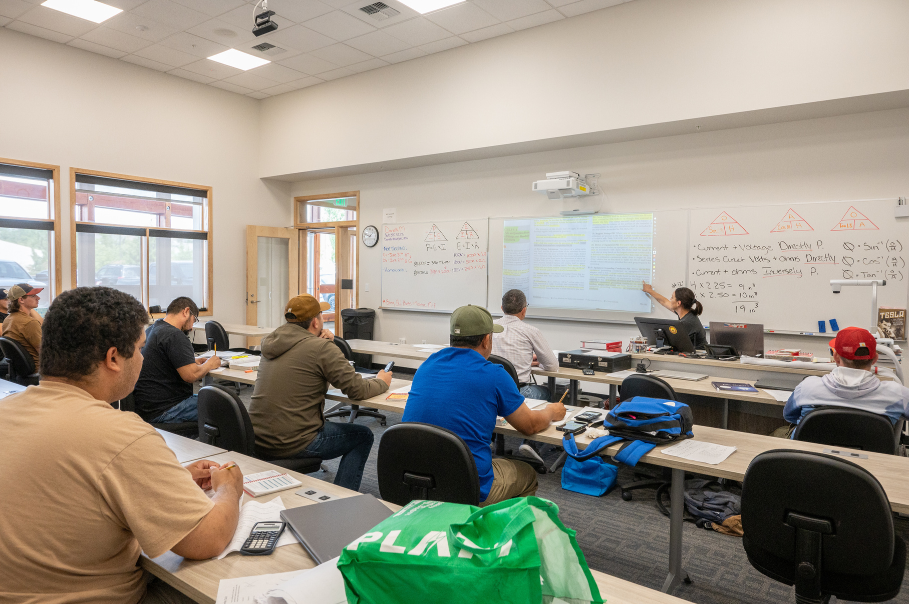
Train with the best

Slide 6
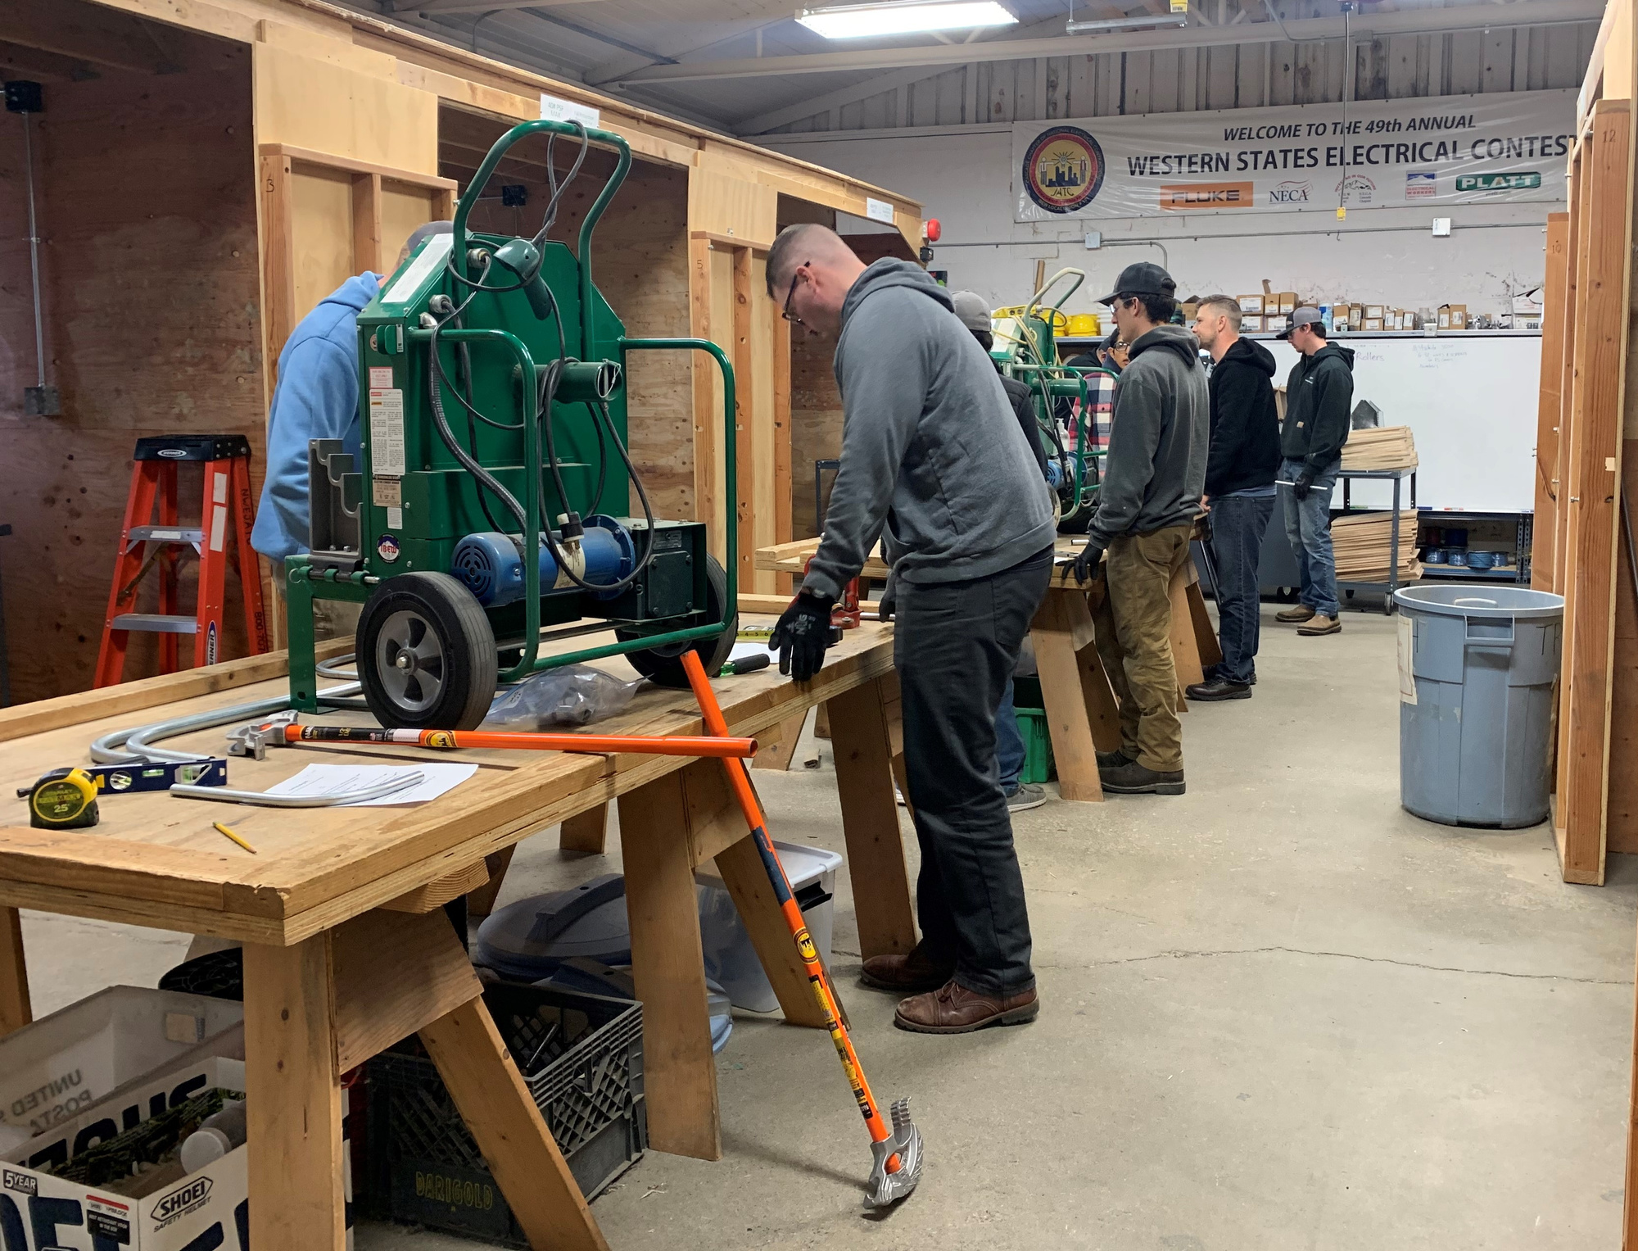
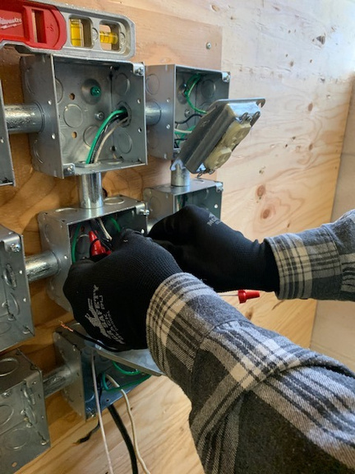

Earn while you learn
A career with a future
Excellent wage rate
Advancement opportunities
Safe working conditions
State-of-the-art training

Slide 7
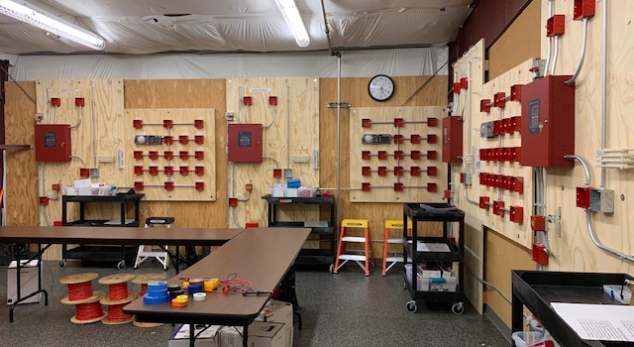
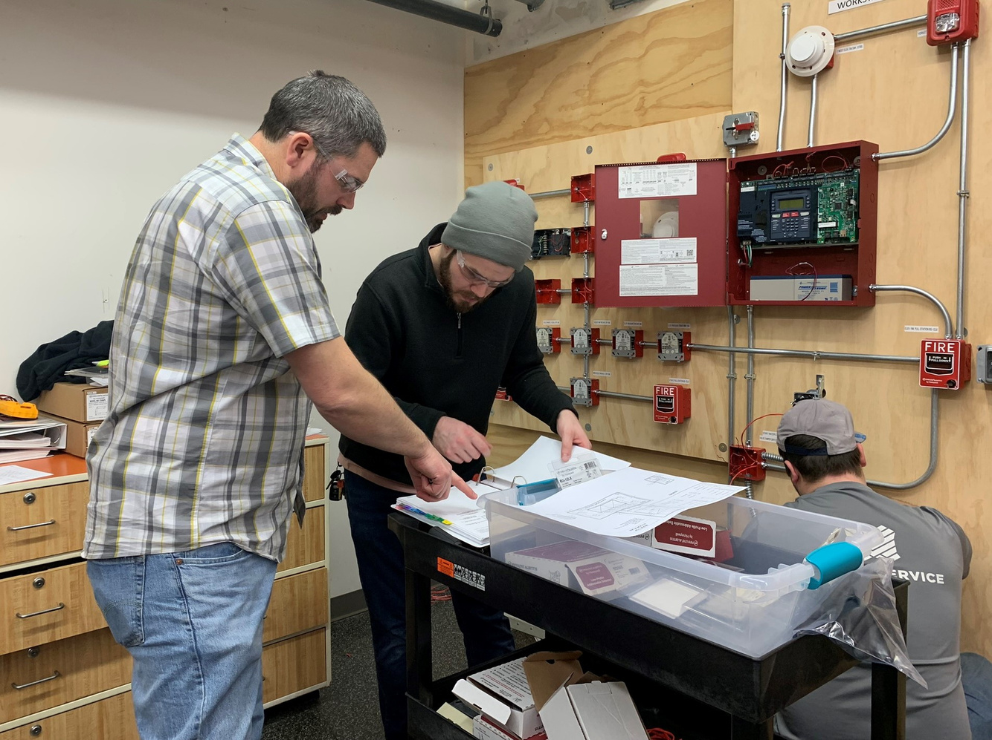
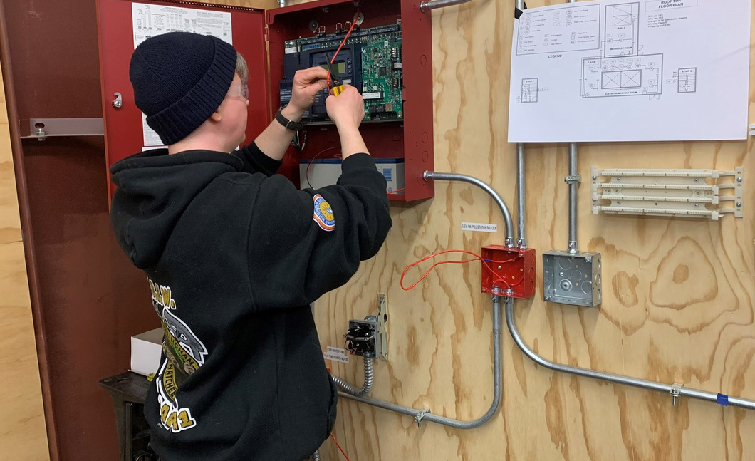
Hands on lab training

Slide 8
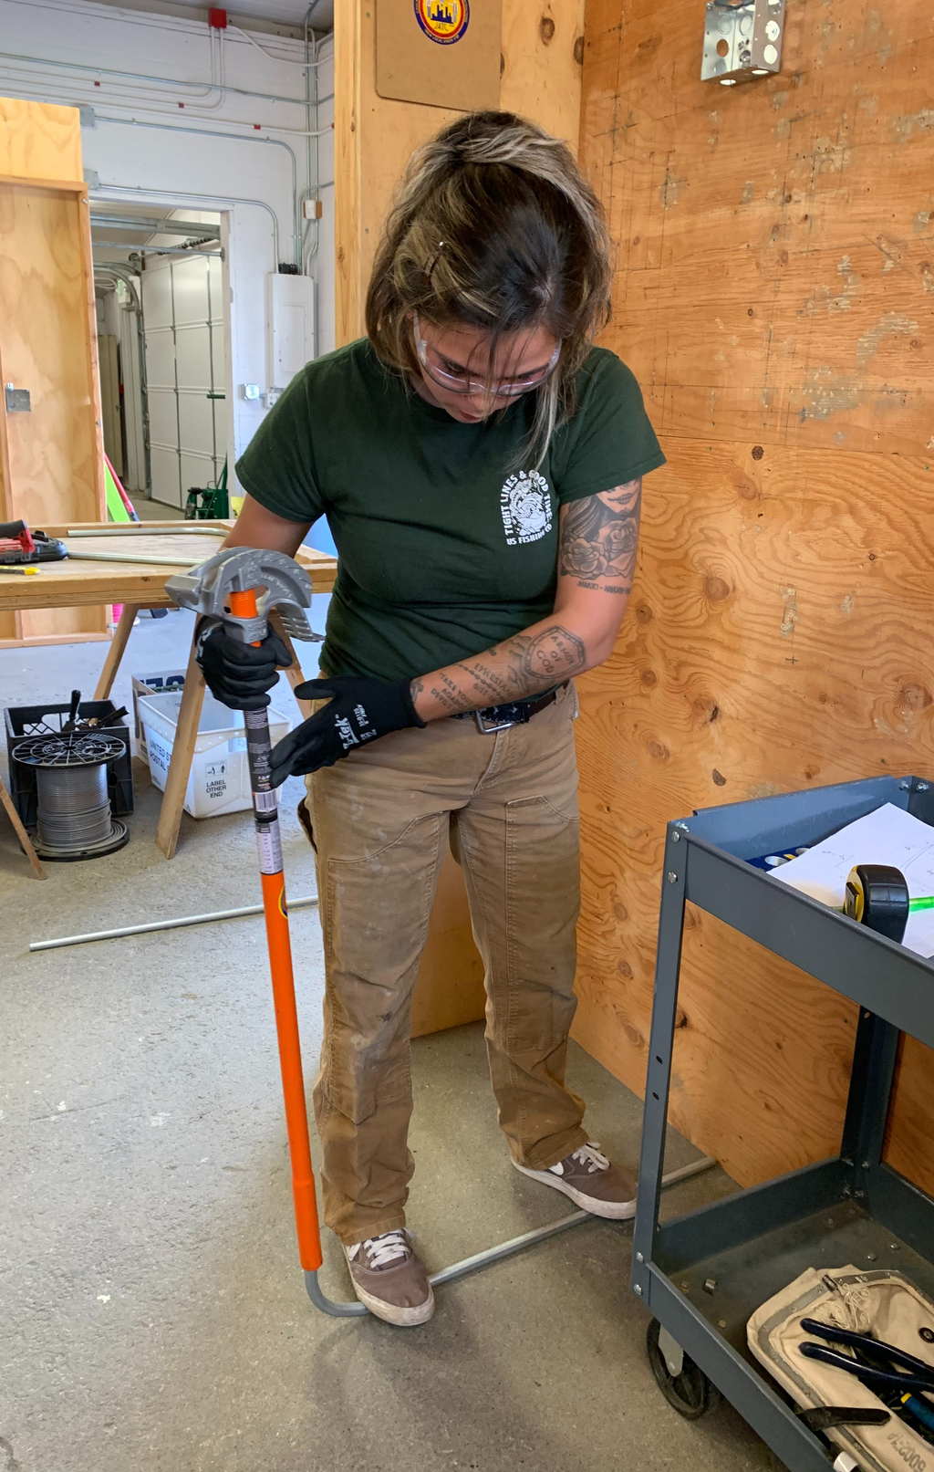
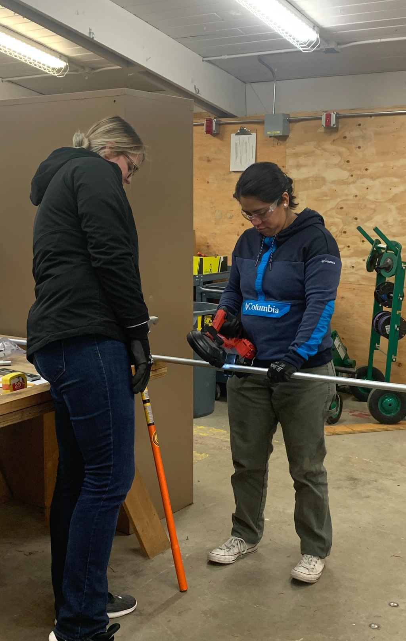
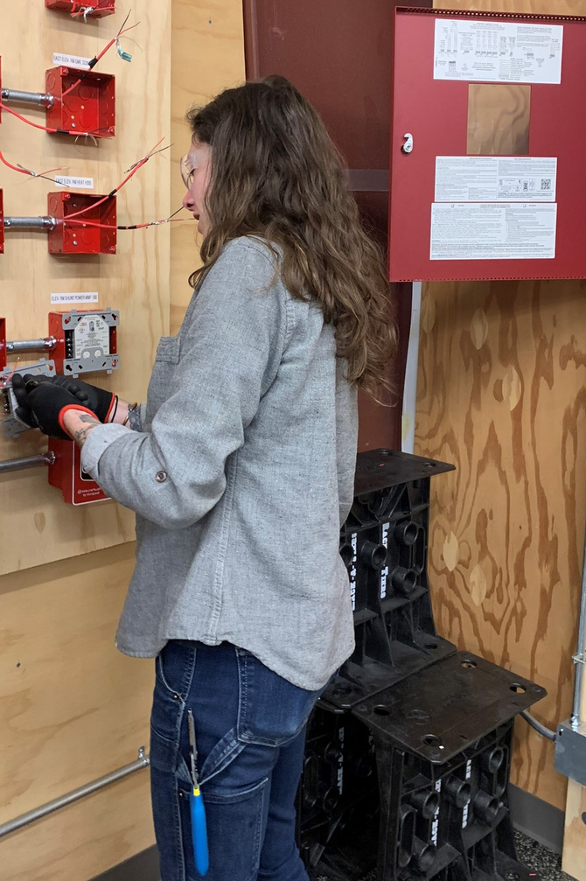
Females
in the trade

Slide 9
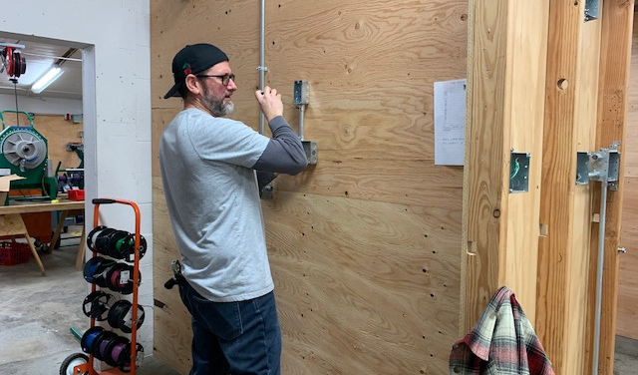
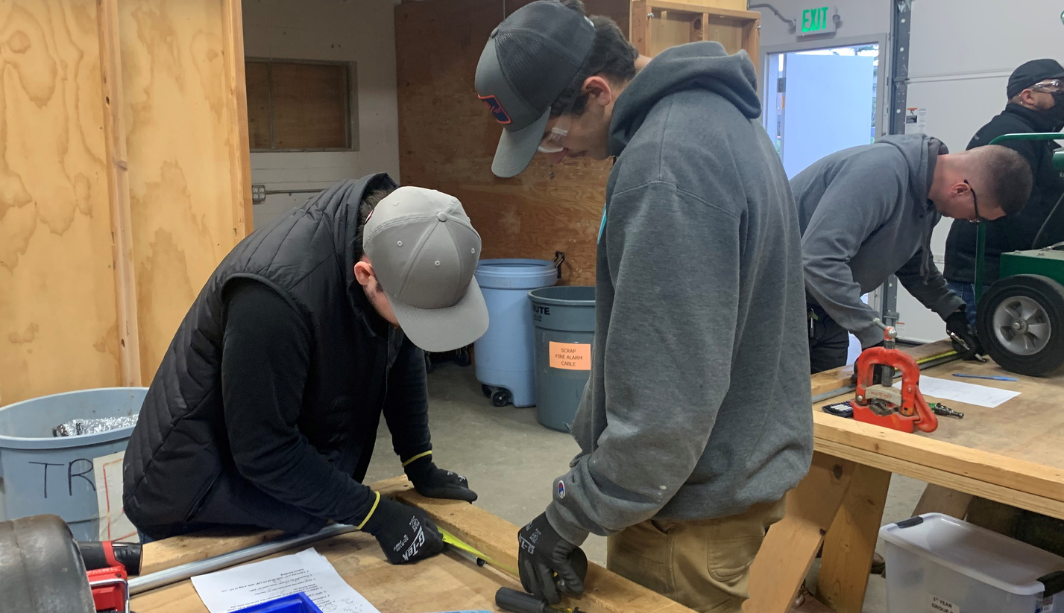
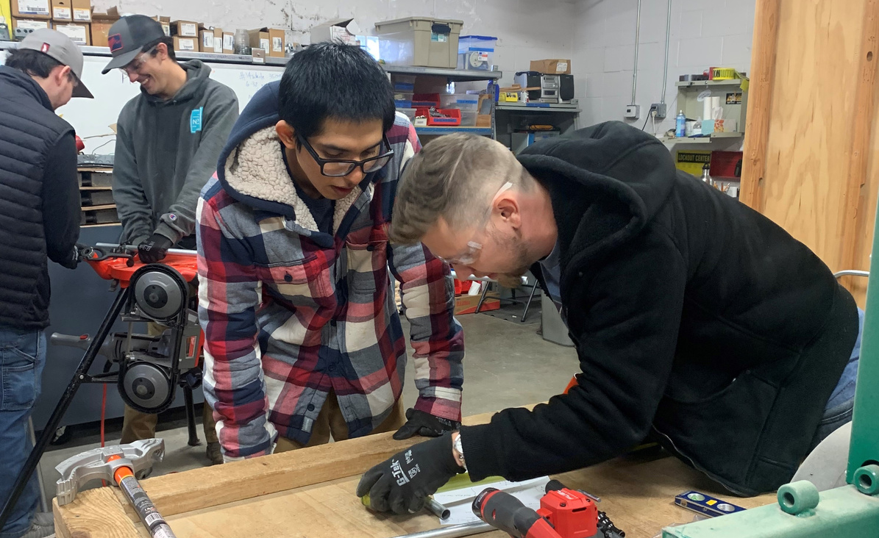
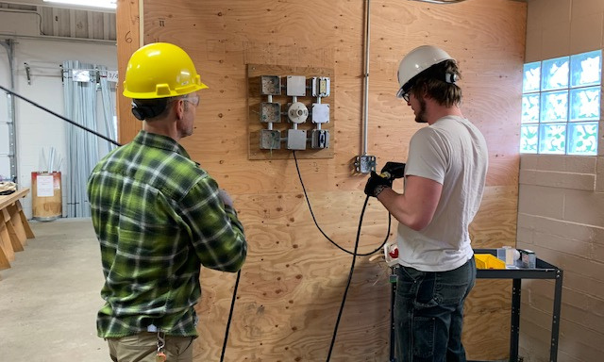

Slide 10
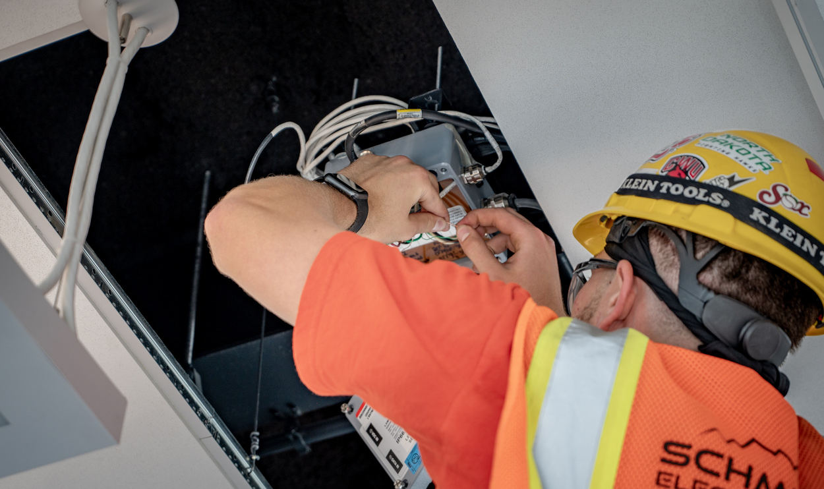
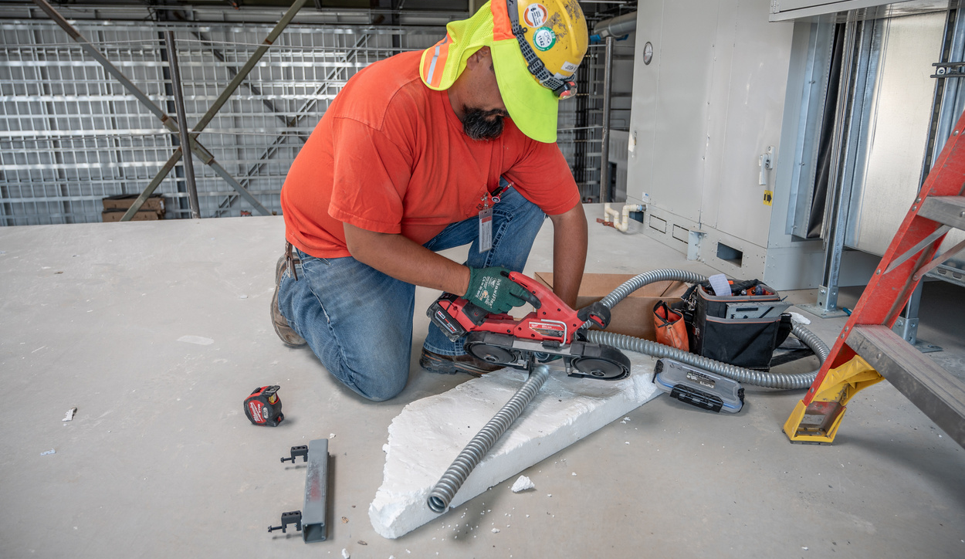
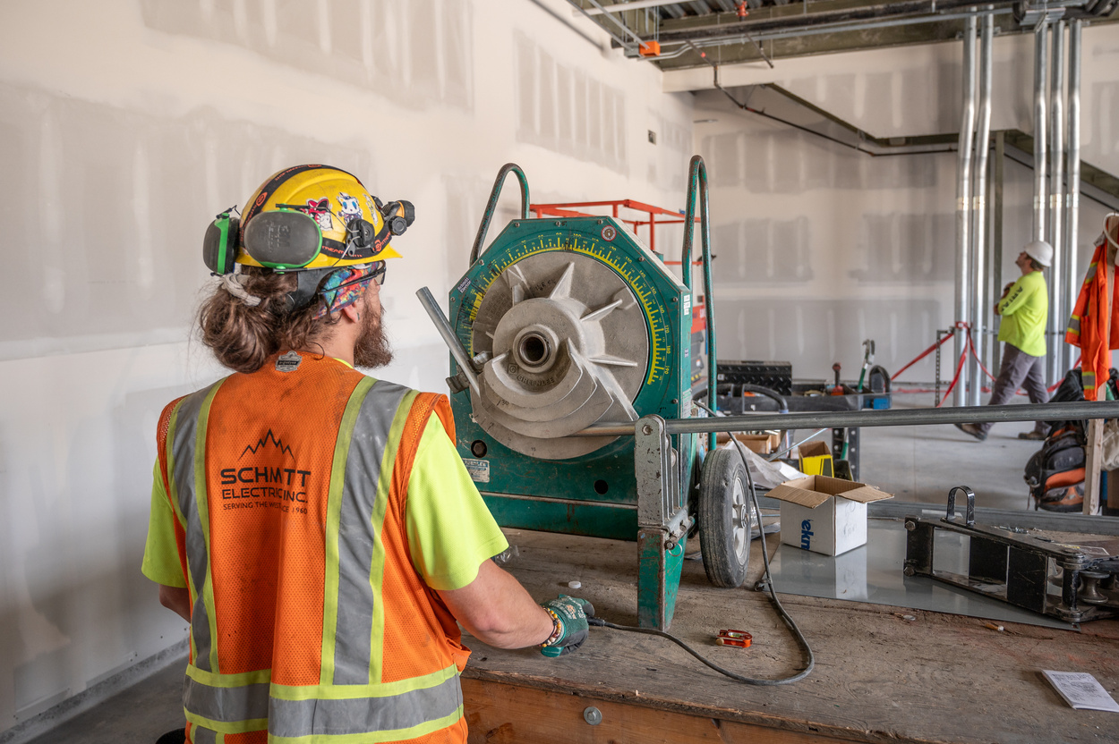
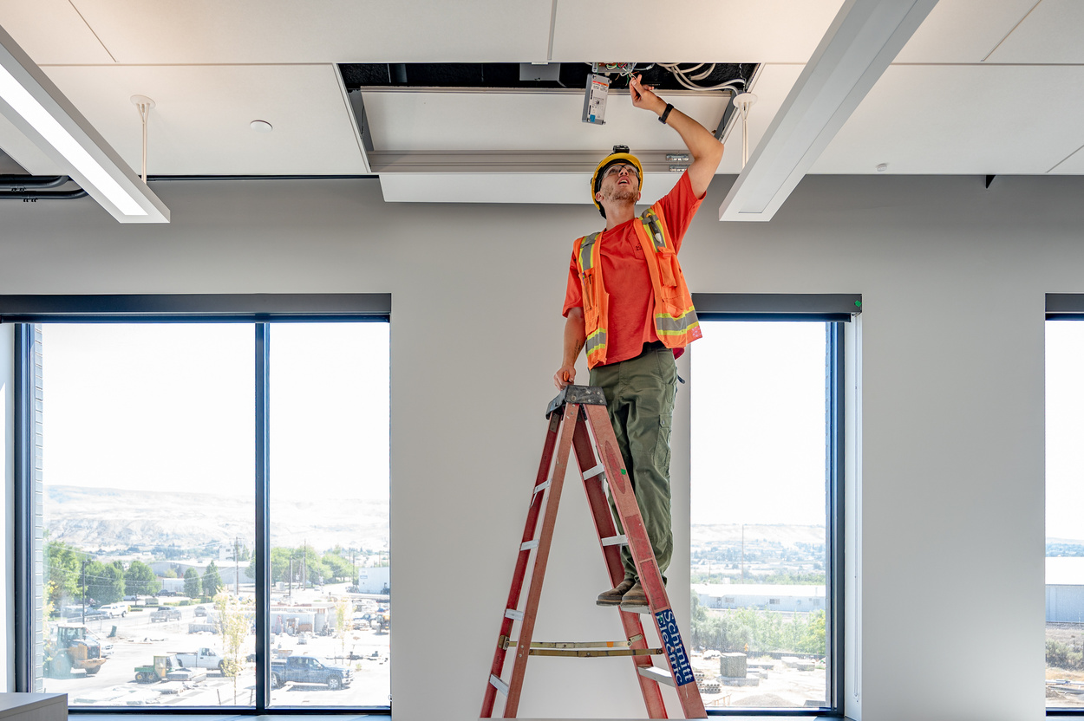
On the Job Training

Slide 11
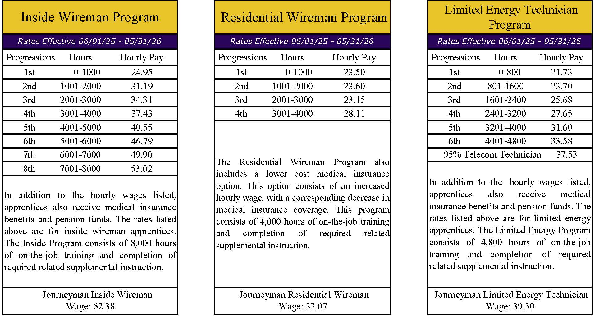

NWEJATC Program Wages

Slide 12
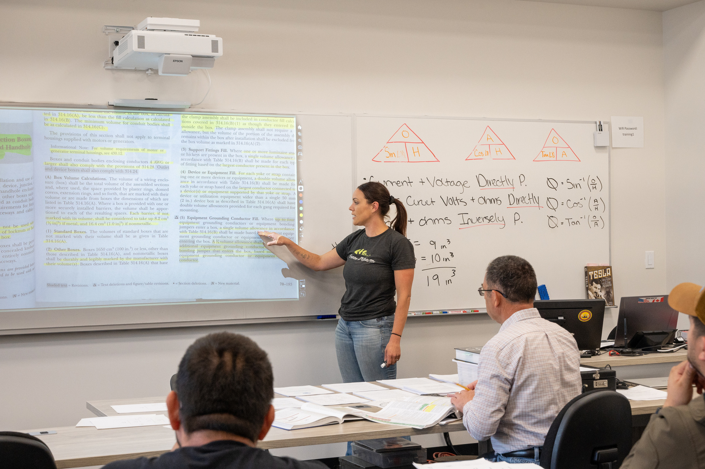
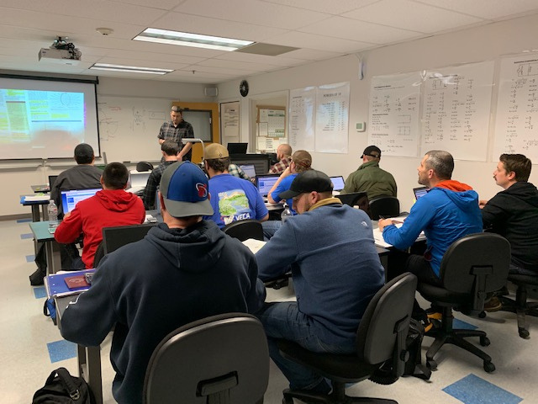
Related Supplemental Instruction

Slide 13
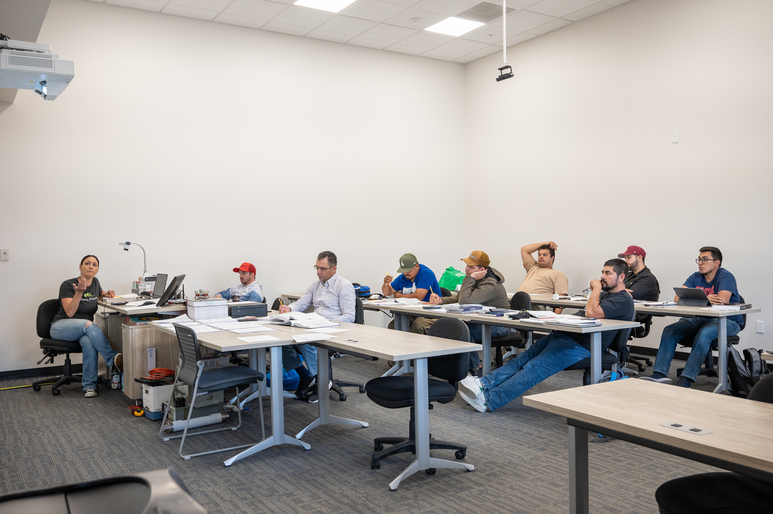
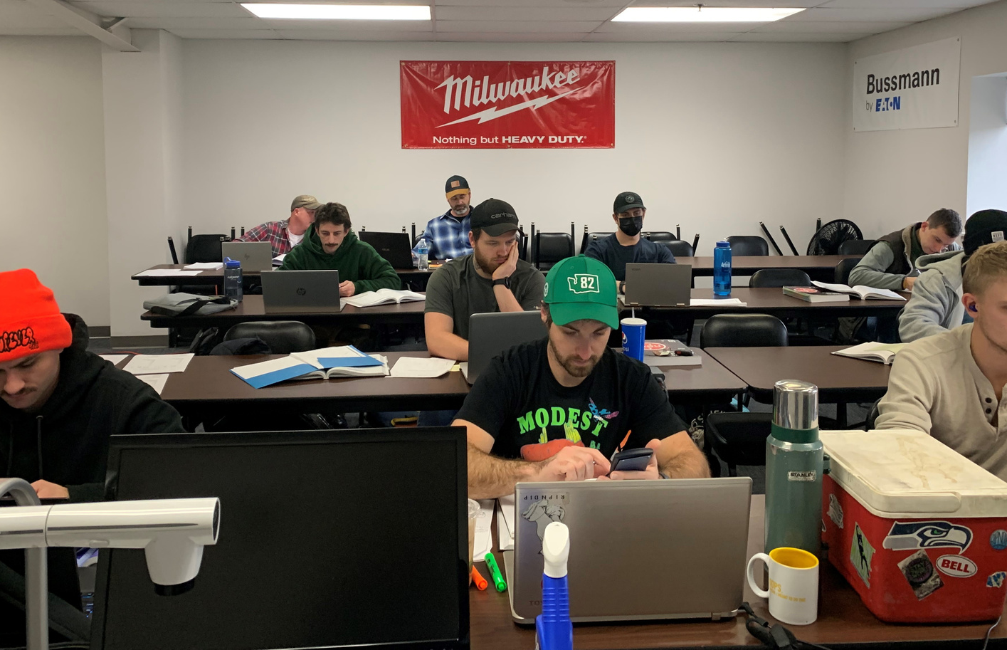
Related Supplemental Instruction

Slide 14
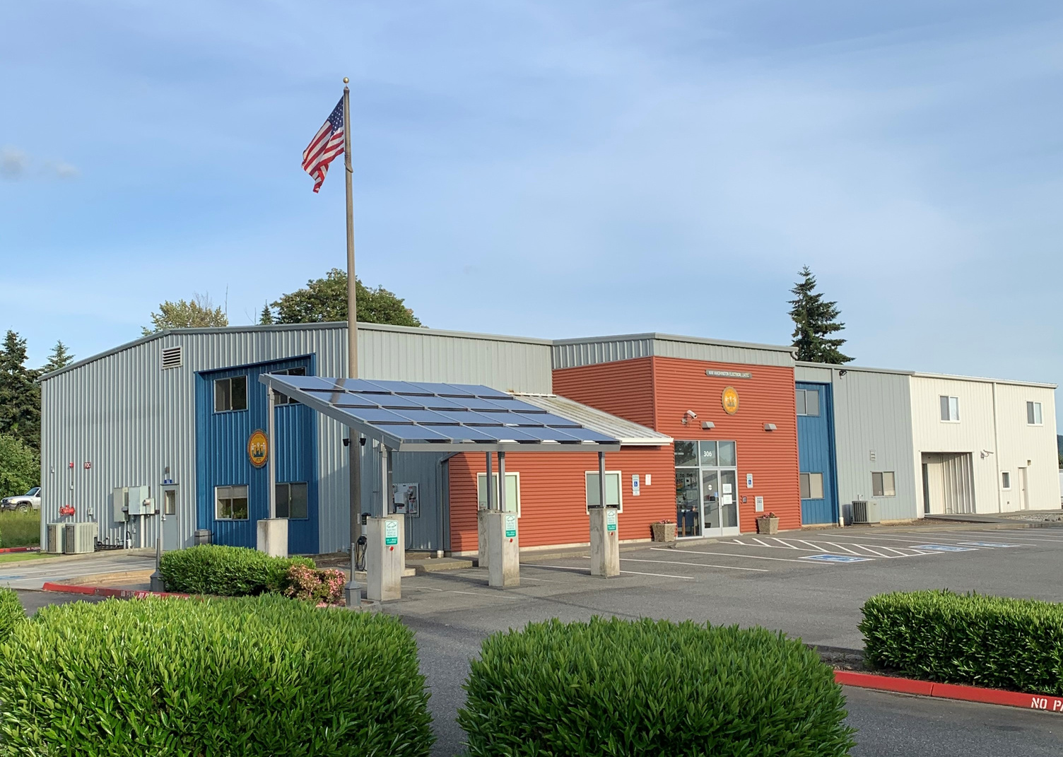
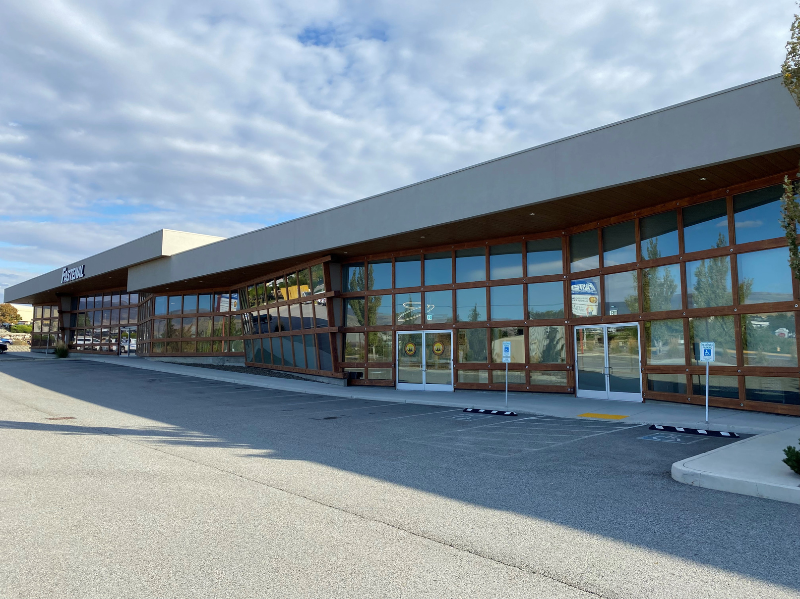
Two Locations
Mount Vernon, WA
East Wenatchee, WA

Slide 15
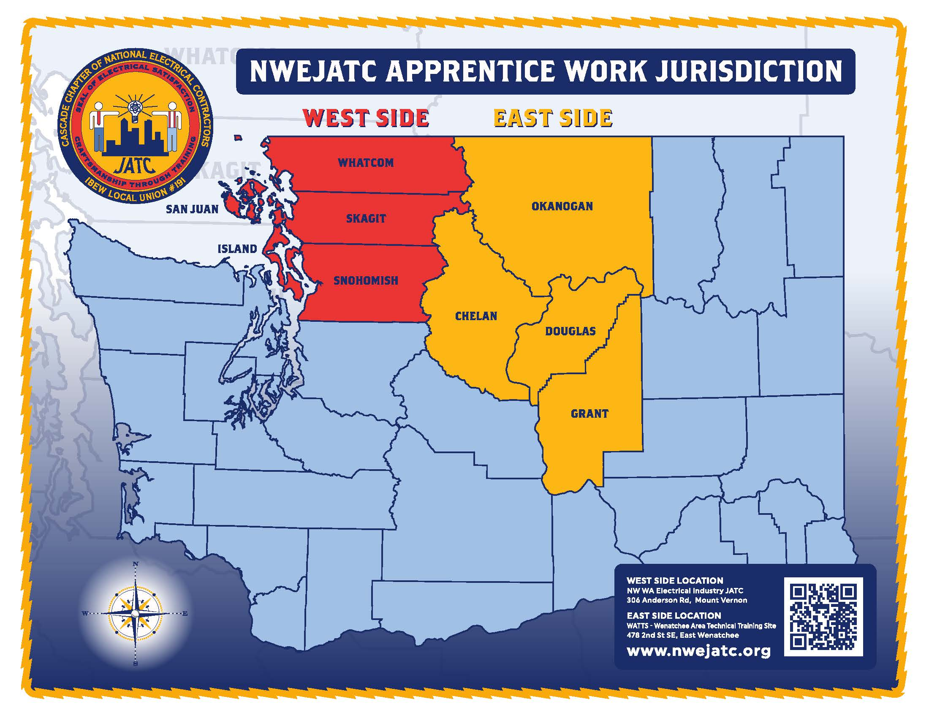

Slide 16
Equal Employment Opportunity Pledge
NWEJATC will not discriminate against apprenticeship applicants or apprentices based on race, creed, color, religion, national origin, sex (including pregnancy and gender identity), sexual orientation, genetic information, marital status, honorably discharged veteran or military status, the presence of any sensory, mental, or physical disability, the used of a trained guide dog or service animal by a person with a disability, or because they are a person 40 years old or older. NWEJATC will take affirmative action to provide equal opportunity in apprenticeship and will operate the apprenticeship program as required under Title 29 of the Code of Federal Regulations, part 30, and RCW 49.60.400.

