Slide 1
Building Strong Foundations: Efficient Construction in Native Communities
Presented By Caleb McGraw
Quick Build Consulting and Construction Services
100% Native owned Company

Slide 2

AGENDA
Introduction
Independent consultant specializing in construction contracts, project delivery and compliance.
Experience supporting tribes, contractors, and owners on efficient project management and construction.

Slide 3

Core Focus
Streamlining Contracts: Clear, enforceable, and aligned with tribal employment and labor rights requirements
Risk Management: Proper scoping, bonding and scheduling to protect contractors and tribes.
Budget & Cost Controls: Strategies for staying within budget, fair payment structures for tribes and small contractors.

Slide 4

Partnership with TERO
Integrate Tero fee requirements and tribal preference policies into bids and contracts.
Support tribes in negotiating fair terms with outside contractors.
Encourage contractors to partner with TERO programs for labor needs.

Slide 5
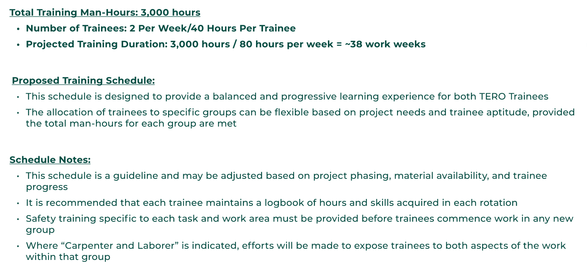
TERO Trainee Work Schedule

Slide 6
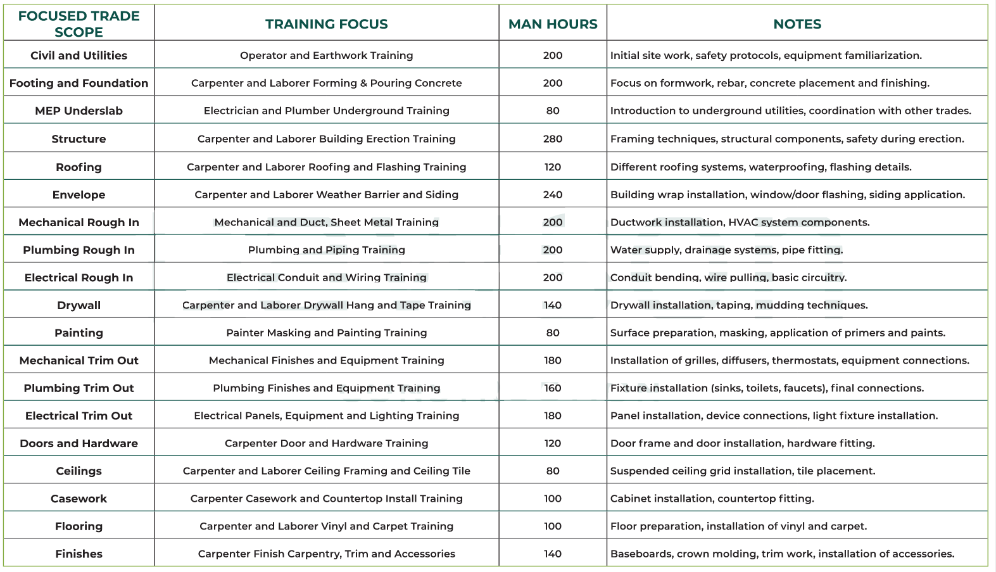

Slide 7
Best Practices
Clear Communication at project onset between tribal governments, TERO and contractors.
Contract clauses to prevent disputes on hiring, safety, costs and scheduling.
Tribes save time and costs through strong contract and project oversight.

Slide 8
Path to success
For contractors: Learn tribal requirements proactively
For tribes: Leverage consultants and TERO for employment goals and deadlines
Build trust-based, transparent relationships for Native community results

Slide 9

Questions? Let’s Discuss
Caleb McGraw, Quick Build Consulting
quickbuildconsulting@gmail.com
907-201-9419

